Slide 1
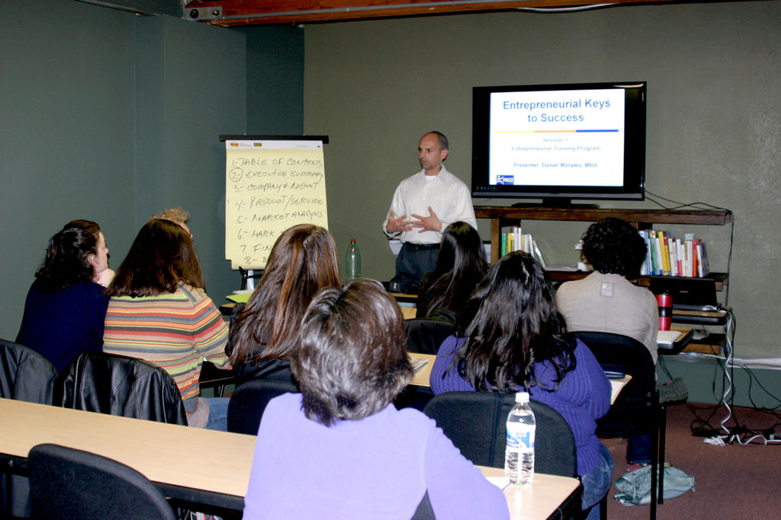

Slide 2
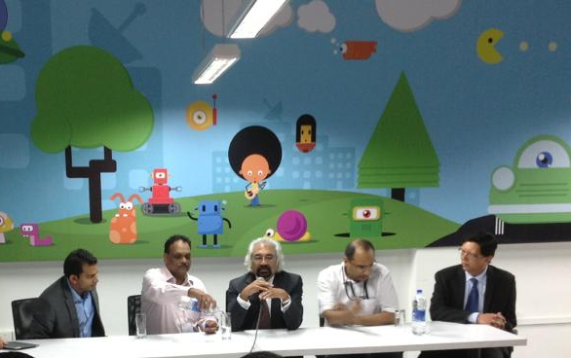

Slide 3
Needs to be fulfilled by the product
Figuring out the correct requirements
is hard!
Figuring out the correct requirements
is hard!

Slide 4



Slide 7
ESTABLISHING requirements

Slide 8
ESTABLISHING requirements
SURVEYS
INTERVIEWS
FOCUS GROUPS
PROD. STUDY
OBSERVE
BRAINSTORM

Slide 9
Don’t just assume. Clarify.

Slide 10

Surveys

Slide 11

Interviews
Yes…
No…
Whatever…
Our product … Do you like ...
Moreover…

Slide 12
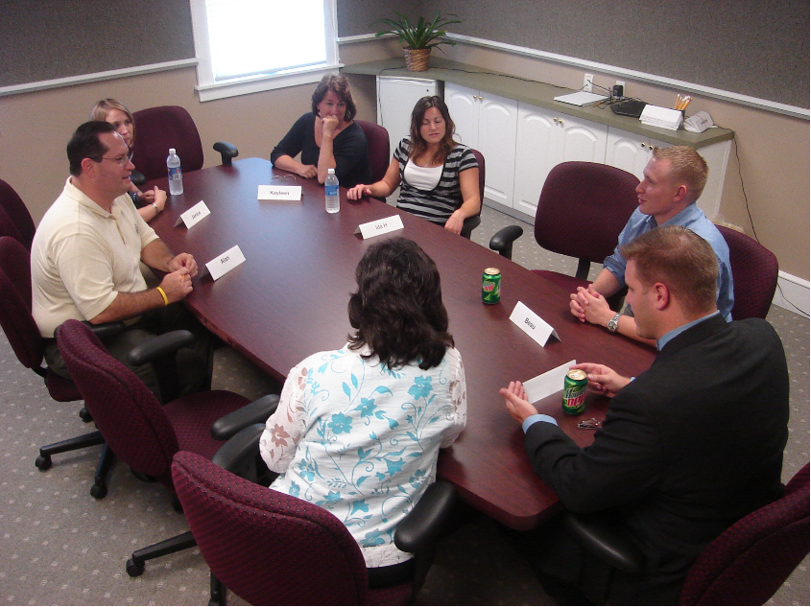
Focus groups

Slide 13
ESTABLISHING requirements
SURVEYS
INTERVIEWS
FOCUS GROUPS
Ask who?
Users
Customers
Investors
Developers
Government
. . .
Stakeholders

Slide 14
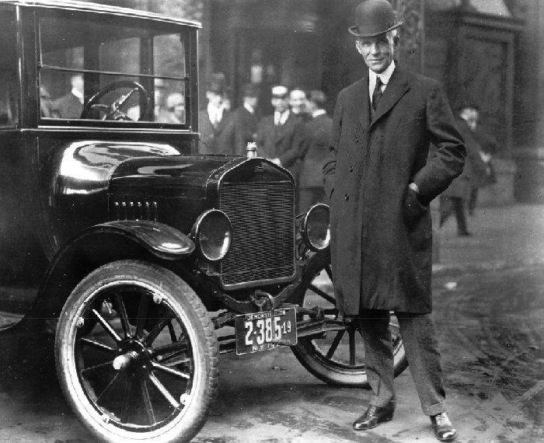
If I had asked my customers what they wanted, they would have said a faster horse.
--Henry Ford
Users can inform about the present, not envision the future

Slide 15
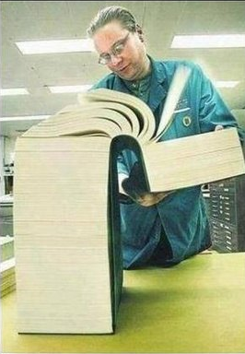
Study existing products

Slide 16
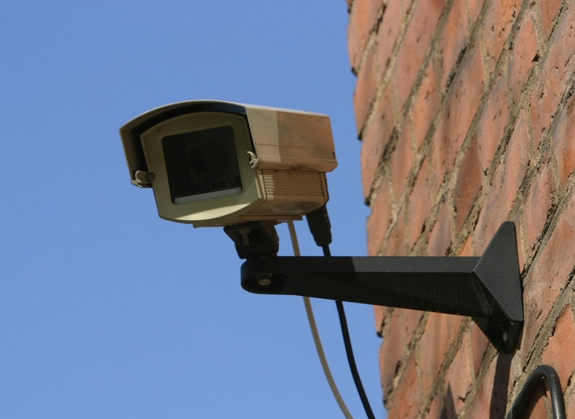
Observe users

Slide 17
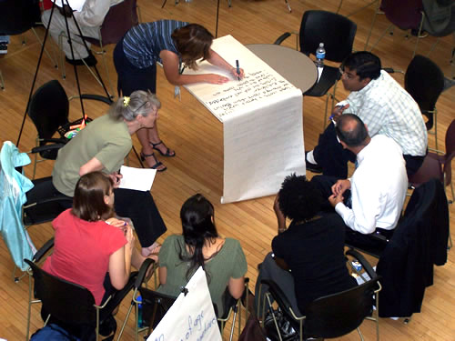
Brainstorm

Slide 18
ESTABLISHING requirements
SURVEYS
INTERVIEWS
FOCUS GROUPS
PROD. STUDY
OBSERVE
BRAINSTORM

Slide 19
ESTABLISHING requirements
SURVEYS
INTERVIEWS
FOCUS GROUPS
PROD. STUDY
OBSERVE
BRAINSTORM

Slide 21
ESTABLISHING requirements
SPECIFYING requirements
SURVEYS
INTERVIEWS
FOCUS GROUPS
PROD. STUDY
OBSERVE
BRAINSTORM

Slide 22
SPECIFYING requirements
PROTOTYPES
FEATURE LIST
USER STORIES
USE CASES
SUPPLEMENTARY
GLOSSARY

Slide 23
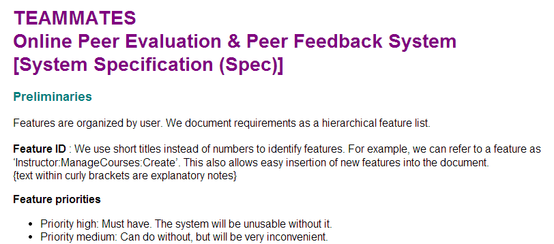
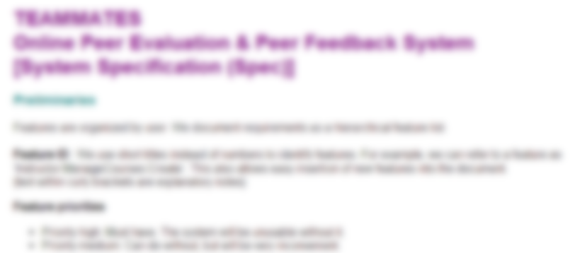
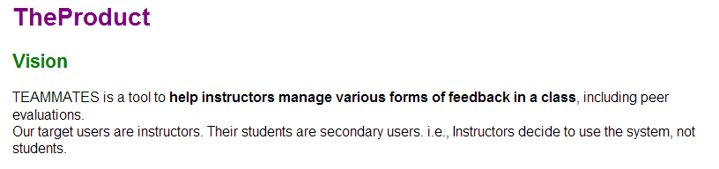
Prose

Slide 24
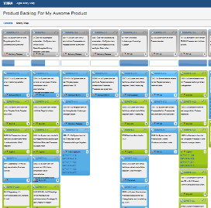
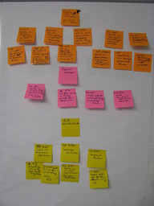
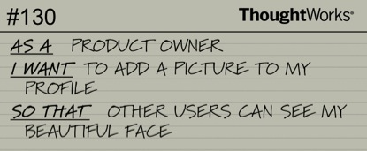
From user’s perspective
User stories
Role
Goal/Function
Benefit

Slide 25
An example in the Duke context
As a user,
I want to be reminded of very old todo items that are not yet done,
so that I can minimize forgetting to do some tasks entirely.

Slide 26
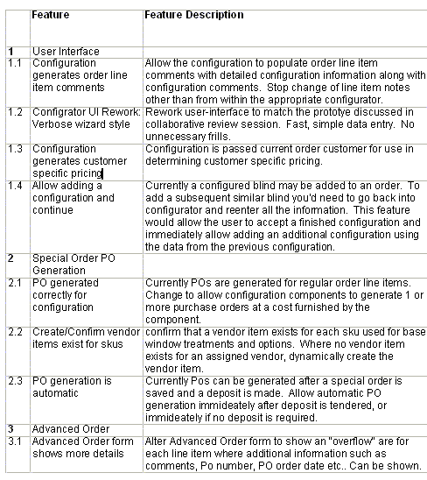
Feature lists

Slide 27
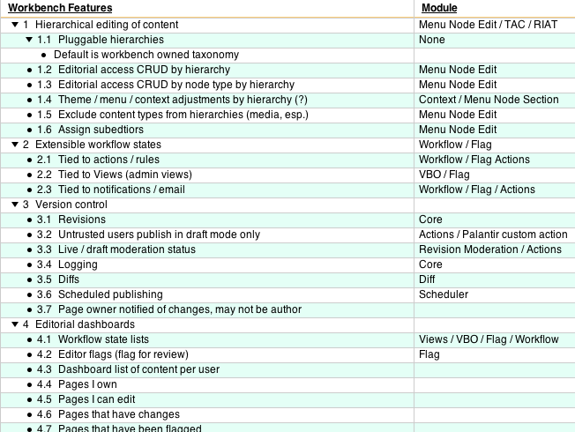
Feature lists

Slide 28
SPECIFYING requirements
PROSE
USER STORIES
FEATURE LIST

Slide 30
SPECIFYING requirements
PROSE
FEATURE LIST
USER STORIES

Slide 31
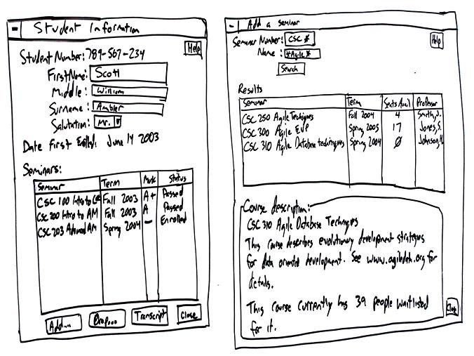
Prototypes

Slide 32
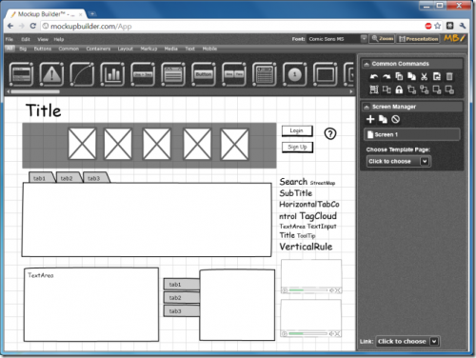
Prototypes

Slide 33
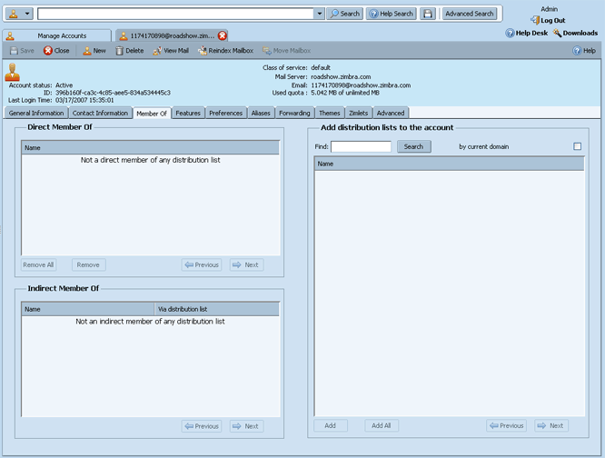
Prototypes

Slide 34
SPECIFYING requirements
PROTOTYPES
PROSE
FEATURE LIST
USER STORIES

Slide 35

Supplementary requirements
Non-functional requirements

Slide 36
SPECIFYING requirements
PROTOTYPES
PROSE
FEATURE LIST
USER STORIES
SUPPLEMENTARY

Slide 37
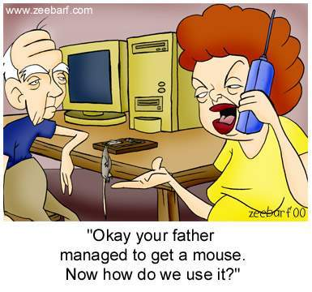

Slide 38
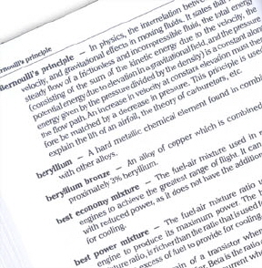
Glossary

Slide 39
SPECIFYING requirements
PROTOTYPES
PROTOTYPES
FEATURE LIST
USER STORIES
PROSE
FEATURE LIST
USER STORIES
PROSE
SUPPLEMENTARY
SUPPLEMENTARY
GLOSSARY

Slide 41
SPECIFYING requirements
PROTOTYPES
PROTOTYPES
Modeling the interactions between the system and the users
FEATURE LIST
USER STORIES
PROSE
FEATURE LIST
USER STORIES
PROSE
USE CASES
SUPPLEMENTARY
SUPPLEMENTARY
GLOSSARY

Slide 42
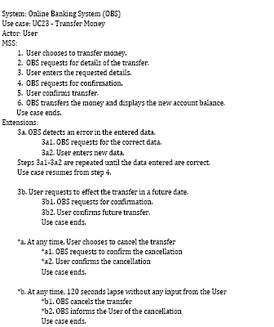

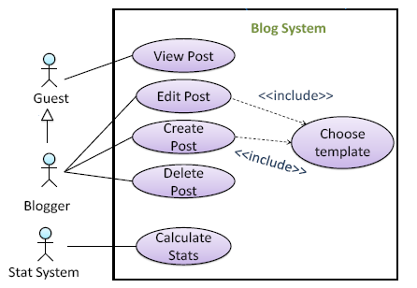
Use Cases

Slide 43
System: Online Banking System (OBS)
Use case: UC23 - Transfer Money
Actor: Customer
Main success scenario:
1. Customer chooses to transfer money.
2. OBS requests for details of the transfer.
3. Customer performs enter transaction details (UC14a).
4. OBS requests for confirmation.
5. Customer confirms transfer.
6. OBS transfers the money and displays status.
Use case ends.

Slide 44
System: Online Banking System (OBS)
Use case: UC23 - Transfer Money
Actor: Customer
Main success scenario:
1. Customer chooses to transfer money.
2. OBS requests for details of the transfer.
3. Customer performs enter transaction details (UC14a).
4. OBS requests for confirmation.
5. Customer confirms transfer.
6. OBS transfers the money and displays status.
Use case ends.

Slide 45
System: Online Banking System (OBS)
Use case: UC23 - Transfer Money
Actor: Customer
Main success scenario:
1. Customer chooses to transfer money.
2. OBS requests for details of the transfer.
3. Customer performs enter transaction details (UC14a).
4. OBS requests for confirmation.
5. Customer confirms transfer.
6. OBS transfers the money and displays status.
Use case ends.

Slide 46
System: Online Banking System (OBS)
Use case: UC23 - Transfer Money
Actor: Customer
Main success scenario:
1. Customer chooses to transfer money.
2. OBS requests for details of the transfer.
3. Customer performs enter transaction details (UC14a).
4. OBS requests for confirmation.
5. Customer confirms transfer.
6. OBS transfers the money and displays status.
Use case ends.

Slide 47
System: Online Banking System (OBS)
Use case: UC23 - Transfer Money
Actor: Customer
Main success scenario:
1. Customer chooses to transfer money.
2. OBS requests for details of the transfer.
3. Customer performs enter transaction details (UC14a).
4. OBS requests for confirmation.
5. Customer confirms transfer.
6. OBS transfers the money and displays status.
Use case ends.

Slide 48
System: Online Banking System (OBS)
Use case: UC23 - Transfer Money
Actor: Customer
Main success scenario:
1. Customer chooses to transfer money.
2. OBS requests for details of the transfer.
3. Customer performs enter transaction details (UC14a).
4. OBS requests for confirmation.
5. Customer confirms transfer.
6. OBS transfers the money and displays status.
Use case ends.

Slide 49
Main success scenario:
1. Customer chooses to transfer money.
2. OBS requests for details of the transfer.
3. Customer performs enter transaction details (UC14a).
4. OBS requests for confirmation.
5. Customer confirms transfer.
6. OBS transfers the money and displays status.
Use case ends.
Extensions
3a. OBS detects an error in the entered data.
3a1. OBS requests for the correct data.
3a2. Customer enters new data.
Steps 3a1-3a2 are repeated until the data entered are correct.
Use case resumes from step 4.

Slide 50
Main success scenario:
1. Customer chooses to transfer money.
2. OBS requests for details of the transfer.
3. Customer performs enter transaction details (UC14a).
4. OBS requests for confirmation.
5. Customer confirms transfer.
6. OBS transfers the money and displays status.
Use case ends.
Extensions
3a. OBS detects an error in the entered data.
3a1. OBS requests for the correct data.
3a2. Customer enters new data.
Steps 3a1-3a2 are repeated until the data entered are correct.
Use case resumes from step 4.

Slide 51
Main success scenario:
1. Customer chooses to transfer money.
2. OBS requests for details of the transfer.
3. Customer performs enter transaction details (UC14a).
4. OBS requests for confirmation.
5. Customer confirms transfer.
6. OBS transfers the money and displays status.
Use case ends.
Extensions
3a. OBS detects an error in the entered data.
3a1. OBS requests for the correct data.
3a2. Customer enters new data.
Steps 3a1-3a2 are repeated until the data entered are correct.
Use case resumes from step 4.

Slide 52
5. Customer confirms transfer.
6. OBS transfers the money and displays status.
Use case ends.
Extensions
3a. OBS detects an error in the entered data.
3a1. OBS requests for the correct data.
3a2. Customer enters new data.
Steps 3a1-3a2 are repeated until the data entered are correct.
Use case resumes from step 4.
*a. At any time, Customer chooses to cancel the transfer
*a1. OBS requests to confirm the cancellation
*a2. Customer confirms the cancellation
Use case ends.

Slide 53

Use Cases
Guarantees, Preconditions, and more….

